Slide 1
Travel Policy/Form Updates, Vendor Stops & Tyler Cashiering
Presented By: Finance Department

Slide 2
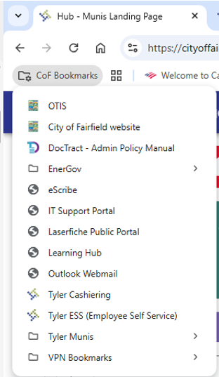
Important Links
Admin Policy – COF Bookmarks after opening Google Chrome https://fairfieldca.public.doctract.com/
Travel Policy is Chapter 100-Admnistration, Section 22 https://fairfieldca.public.doctract.com/doctract/documentportal/08DA1DA285CBB2C580FB05880966BD8F
New Travel Authorization Form – Documents & Information page on OTIS
Travel Authorization and Reconciliation Form 2025
Tyler Guides – ERP Page on OTIS (scroll to bottom)
https://otis.fairfield.city/services/erp-fairfield-fast-forward

Slide 3
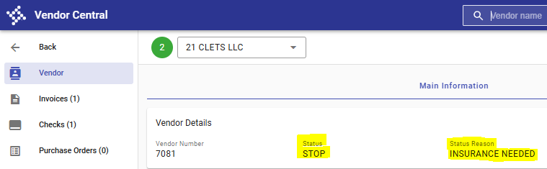
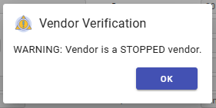
Vendor Stops in Tyler
-Departments should check for Insurance compliance BEFORE using a Vendor and them coming onsite.
-Risk will be updating the Vendor’s status in Tyler for Insurance compliance at the end of each week.
Vendors will be updated to STOP status in Tyler and will show INSURANCE NEEDED as the Status Reason
The below message will appear in Invoice Entry if the Vendor has a STOP status and will not allow you to enter an invoice.
Questions? Contact Erika Milton – emilton@fairfield.ca.gov

Slide 4
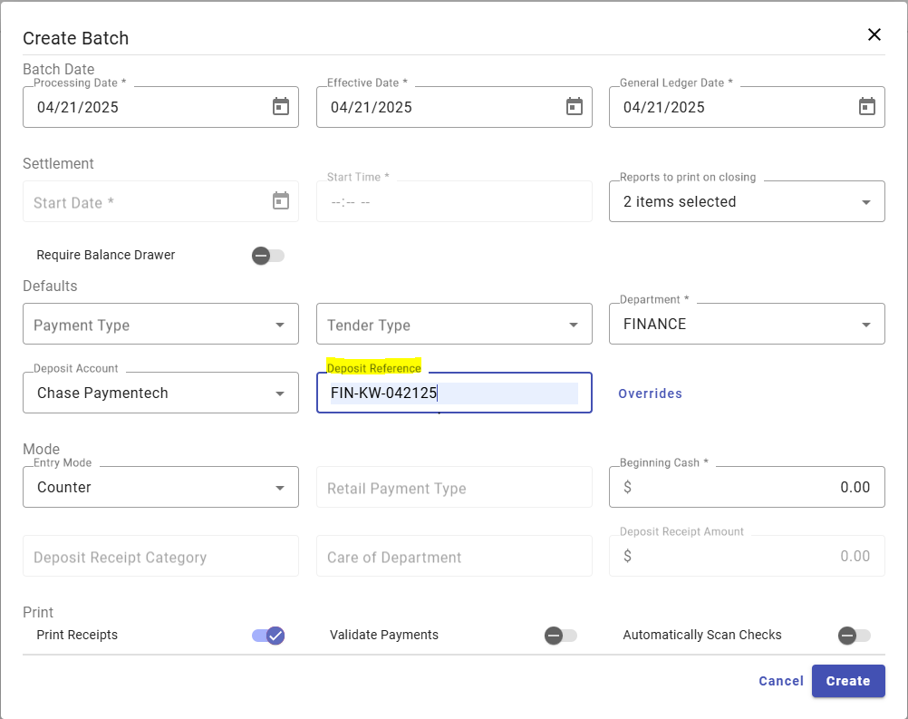
Tyler Cashiering Reminders
Deposit Reference: Enter the deposit reference as Department-Initials-MMDDYY Date
Department Initials:
•Building: BLD-KW-042125
•Planning: PLN-KW-042125
•Public Works: PW-KW-042125
•Econ Dev: ED-KW-042125
•Fire: FIRE-KW-042125
•Finance: FIN-KW-042125
•Police: PD-KW-042125
•Transit: TRA-KW-042125

Slide 5
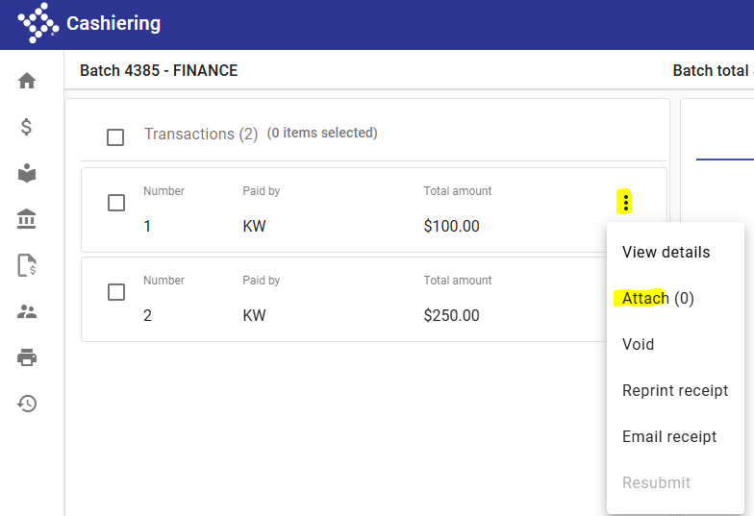
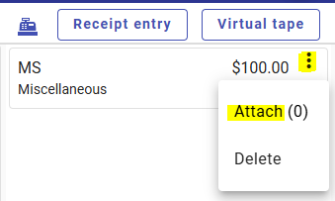
Tyler Cashiering Reminders (Cont’d)
Attaching Documents: Required for check payments. If you do not have a Check Scanner at your workstation, scan the check to your computer first and attach from there.
1) Receipt Entry Screen-Once a transaction has been added to the cart, click the ellipsis and select Attach.
2) Virtual Tape Screen-If you have already completed the transaction, you can select Virtual Tape above your cart. This will show you a list of all transactions taken in your batch for the day. Find the transaction you are adding an attachment to, click the ellipsis and select Attach.

Slide 6
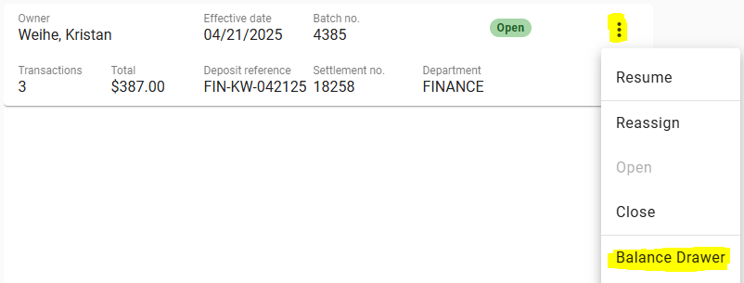
Closing a Cashiering Batch
All Cashiering Batches should be Balanced and Finalized at the end of every day and any checks/cash sent down to Finance.
Click on the Ellipsis and select Balance Drawer.

Slide 7
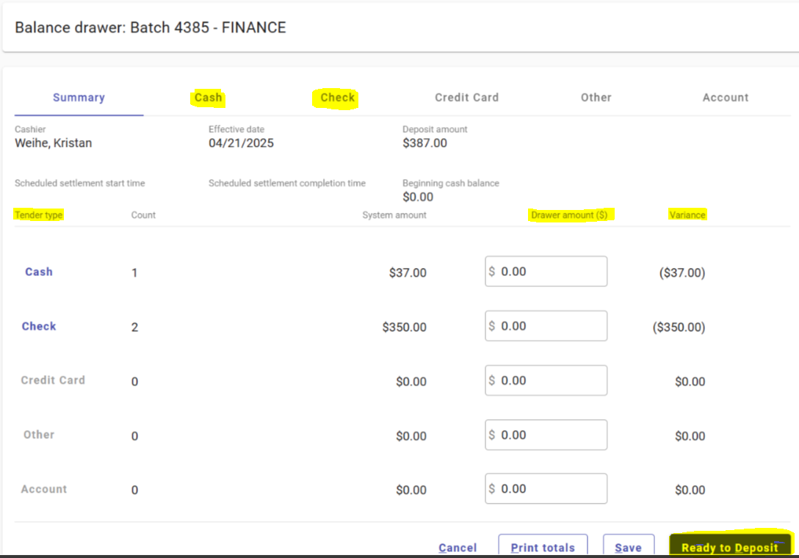
Closing a Cashiering Batch (Cont’d)
Balance each Tender Type by going to the separate tabs and clicking Accept. This is the verification that what was entered in Cashiering matches the physical amount of checks & cash received.
Variance should be $0 once all Tender Types are balanced. Click Ready to Deposit.

Slide 8
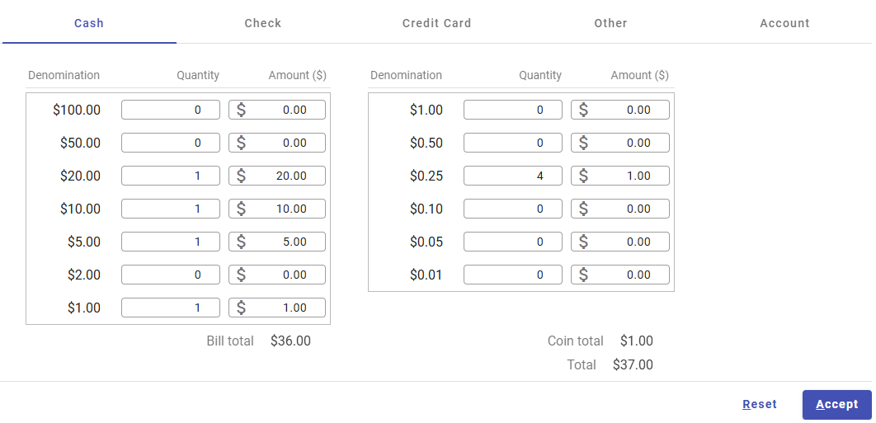
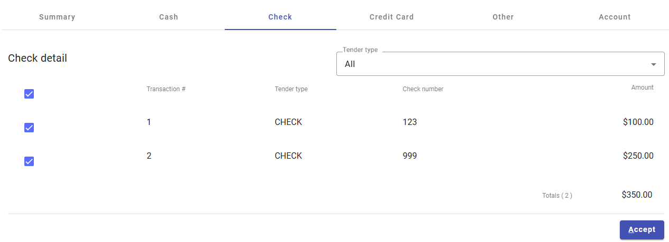
Closing a Cashiering Batch (Cont’d)

Slide 9
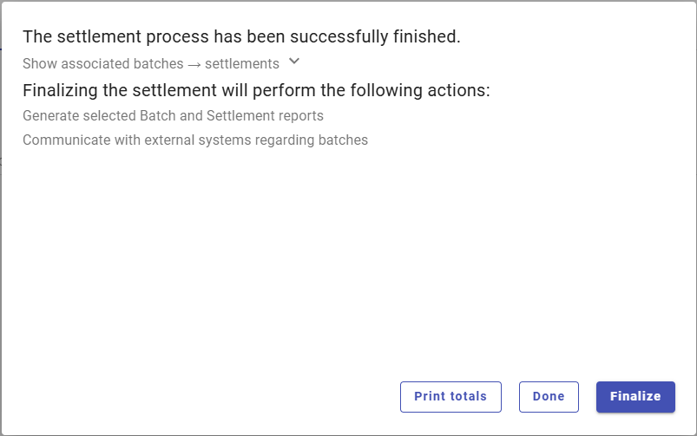
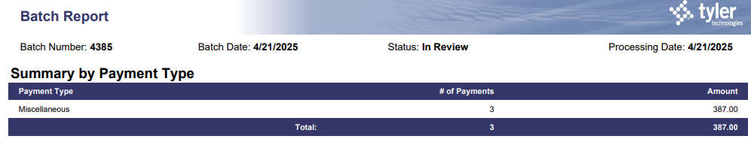
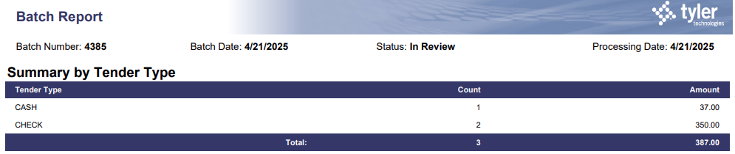
Closing a Cashiering Batch (Cont’d)
Click Finalize. Tyler will open two new windows with the Batch Reports & Settlement Reports. Send the last two pages from the Batch Report window (Summary by Payment Type & Summary by Tender Type) to Finance.

Slide 10
Travel Policy Procedures & Form
-Travel Authorization Form needs to be filled out for Anticipated Costs & approved by all appropriate parties BEFORE travel can be booked.
  Exception can be made for Registration fees for early-bird pricing if you have written consent.
  Pre-Travel:
  Fill out Employee & Conference/Training Information
  Fill out the Anticipated Costs column (and Payment Type, if known). Use the Per Diem Calculator worksheet to determine total per diems based on the GSA rate.
  Print Travel Form and have Employee, Department Head & City Manager (if out-of-state or for Dept Head) sign and date under Pre-Travel Approval Signatures. Include relevant back-up documents for justification of costs.
  Once approved, employees can book travel arrangements.

Slide 11
Travel Policy Procedures & Form
  Post-Travel:
  Using the same Excel file, fill out the Payment Type and Actual Costs columns.
  The Employee Reconciliation box should automatically calculate the amount due to/from the employee.
  Print Travel Form and have Employee, Department Head & City Manager (if out-of-state or for Dept Head) sign and date under Post-Travel Approval Signatures. Include all receipts and relevant back-up documents that tie to the Actual Costs, as well as a copy of the signed Anticipated Costs Travel Form to show that the travel was approved ahead of time.
  Once the Post Travel is approved by all appropriate parties, the reimbursement request to the employee can be entered in Tyler for the Amount Due to Employee.
  Reminder: The Travel Authorization Form and conference flyer/brochure should be included with all P-card transactions, check requests, and employee advance per diem requests/reimbursements submitted for payment.

Slide 12
Travel Policy Reminders/Updates
Mileage:
  Reimbursed at the shorter of the employee’s home or the normal work location (normally City Hall) to and from the actual training location.
  Travel by private vehicle is authorized in lieu of flying when it does not necessitate more time away from the job. The total travel cost comparison shall be computed before the Travel Authorization Form is approved and in no case shall it exceed the round trip by air.
Parking:
  Airport parking is at long-term economy rate (employee is responsible for any rate difference).
  Hotel parking should be at self-parking rate whenever possible.
Airfare:
  Economy class fares only (does not include premium). Upgraded boarding/check-in fees are not allowed.
  If an employee chooses to extend for personal purposes, any additional costs resulting from this extension are the responsibility of the employee. Documentation (flight printouts at the time of booking) must be submitted.
Hotel:
  Out-of-town travel is defined as a location greater than 1.5 hours’ drive of normal commute time from City Hall or as authorized by the city manager.
  Allowable expense for the evening preceding a training, meeting, or conference only when approved by the department head or their designee and budget is available.

Slide 13
Per Diem Calculations
-Encouraged to receive Per Diem post-travel for streamlined processing. Advance Per Diem is still allowed if needed and must be checked on the Travel Authorization Form.
-Out of Town Travel: For the first and last day of travel, an employee is limited to 75% of the applicable per diem rate. If the employee leaves before 9:00 a.m. or the employee returns after 6:00 p.m. on the first and last day, the employee is eligible for 100% of the per diem for those days.
-Commuter Training: if the travel day is over 12 hours (including commute time), the 75% per diem amount is authorized (reduced by any meals provided). For commuter travel that is less than 12 hours, if a full day is scheduled, then lunch per diem is provided.
-When meals are included as part of the event, employees will not be provided per diem for these meals and are deducted at full per diem rate for that meal. No meals should be charged to a P-Card.

Slide 14
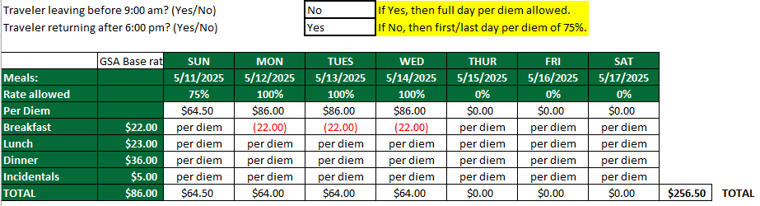
Per Diem Example 1
Example 1: Employee is attending a conference in Los Angeles and is leaving at 3pm on Sunday for training that starts at 8am Monday morning and ends at 4pm on Wednesday, with employee arriving home at 8pm. Breakfast is provided by the conference Monday thru Wednesday.

Slide 15
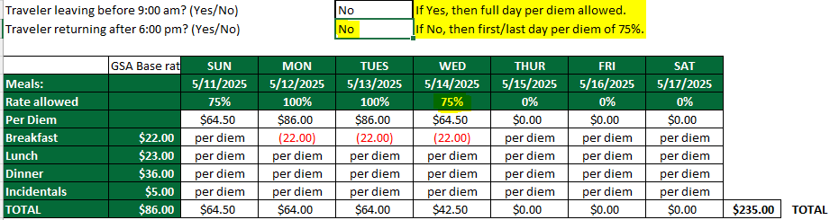
Per Diem Example 2
Example 2: Employee is attending a conference in Los Angeles and is leaving at 3pm on Sunday for training that starts at 8am Monday morning and ends at noon on Wednesday, with employee arriving home by 5pm. Breakfast is provided by the conference Monday thru Wednesday.

Slide 16
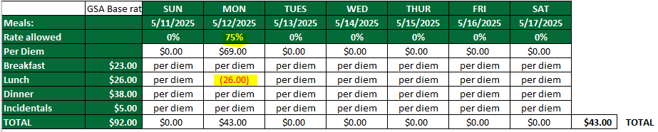
Per Diem Example 3
Example 3: Employee is attending a training on a Monday in San Jose that starts at 8am and ends at 6pm. With commute time from Fairfield, the employee will be gone for over 12 hours. Lunch is provided at the training.

Slide 17
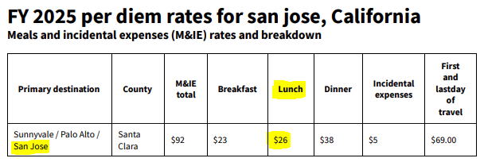
Per Diem Example 4
Example 4: Employee is attending a training on a Monday in San Jose that starts at 9am and ends at 4pm. With commute time from Fairfield, the employee will be gone for about 10 hours. No meals are provided at the training.
If lunch was provided at the training, employee would receive $0 Per Diem.

